Slide 1


Credit Card Fraud Detection
By: Mansi Choudhary

Slide 2


Overview
Introduction
01
Literature Review
02
Data Collection
03
Data Preprocessing
04
Feature Selection
05
Machine Learning Models
06
Evaluation Metrics
07

Slide 3


INTRODUCTION
Overview of credit card fraud and its impact on individuals and businesses :
Credit card fraud is a type of financial fraud. It involves the unauthorised use of someone's credit card information to make fraudulent transactions, leading to financial losses for the cardholder. It is a form of identity theft because it often requires stolen personal information to perpetrate the fraud
Fraud can also hurt customer retention and decrease customer lifetime value (LTV). If a customer disputes a charge on their credit card bill, the business may be required to pay a chargeback fee. Additionally, many payment processing providers charge additional fees to businesses that have a higher chargeback ratio

Slide 4
Significance of developing effective fraud detection methods
Protecting Finances: Fraud can result in significant financial losses for individuals, businesses, and governments. Effective detection methods help minimize these losses by identifying fraudulent activities early on.
Maintaining Trust: Fraud can erode trust between customers, businesses, and financial institutions. By implementing robust fraud detection measures, organizations can demonstrate their commitment to protecting their customers and stakeholders, thereby preserving trust and reputation.
Compliance: Many industries are subject to regulatory requirements regarding fraud prevention and detection. Implementing effective fraud detection methods helps organizations comply with these regulations, avoiding legal penalties and reputational damage
Data Security: Fraud detection often involves monitoring and analyzing large volumes of data. Developing effective fraud detection methods necessitates robust data security measures to protect sensitive information from unauthorized access and misuse.
Customer Protection: Effective fraud detection methods help protect customers from identity theft, financial scams, and other fraudulent activities. This enhances customer satisfaction and loyalty, as customers feel safer and more confident conducting transactions with the organization

Slide 5

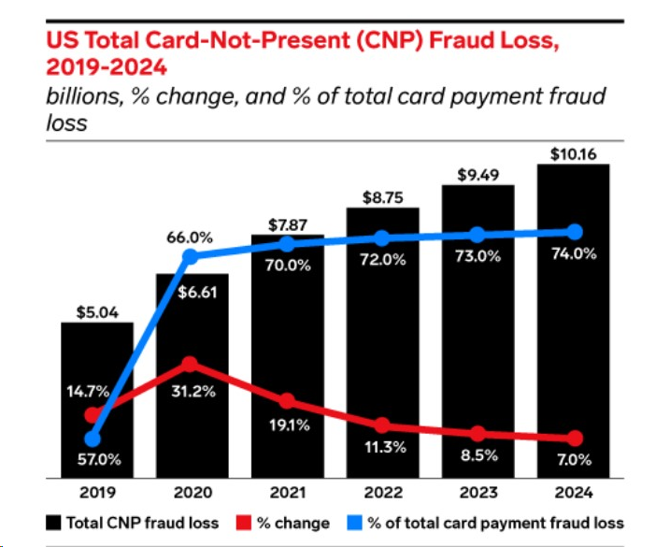
Statistics

Slide 6

LITERATURE REVIEW
Below is link for existing literature on credit card fraud detection :
Existing literature on credit card fraud detection techniques
Models used in previous research paper:
Cleaned the data
They acquired the result of an accurate value of credit card fraud detection i.e. 0.9994802867383512 (99.93%) using a random forest algorithm.

Slide 7

Strengths:
They acquired the result of an accurate value of credit card fraud detection i.e. 0.9994802867383512 (99.93%) using a random forest algorithm.
Limitations :
Imbalanced data is not handled
Data Visualizations was not good enough

Slide 8

DATA COLLECTION
Data Collected from Kaggle
https://www.kaggle.com/datasets/mlg-ulb/creditcardfraud
Discuss the importance of having labeled data:
Labeled data is crucial for training and evaluating machine learning models. It provides the ground truth necessary for algorithms to learn patterns, make predictions, and assess performance accurately. Labeled data enables model development, validation, and generalization to new scenarios, ensuring reliable and effective machine learning applications

Slide 9

DATA PREPROCESSING
Steps:
Loaded the dataset
Checking for null values
Checking for duplicates value
Delete the non important features
Feature Selection
SMOTE
ML

Slide 10


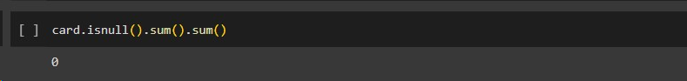
Data Cleaning
After removing duplicates values
No null values

Slide 11
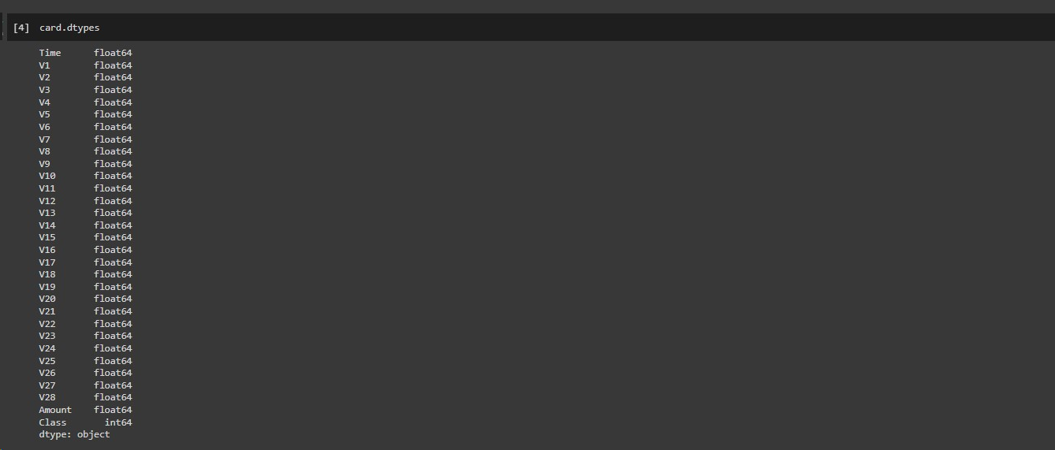
All data types was in float no need to do label encoding or 1-hot encoding

Slide 12

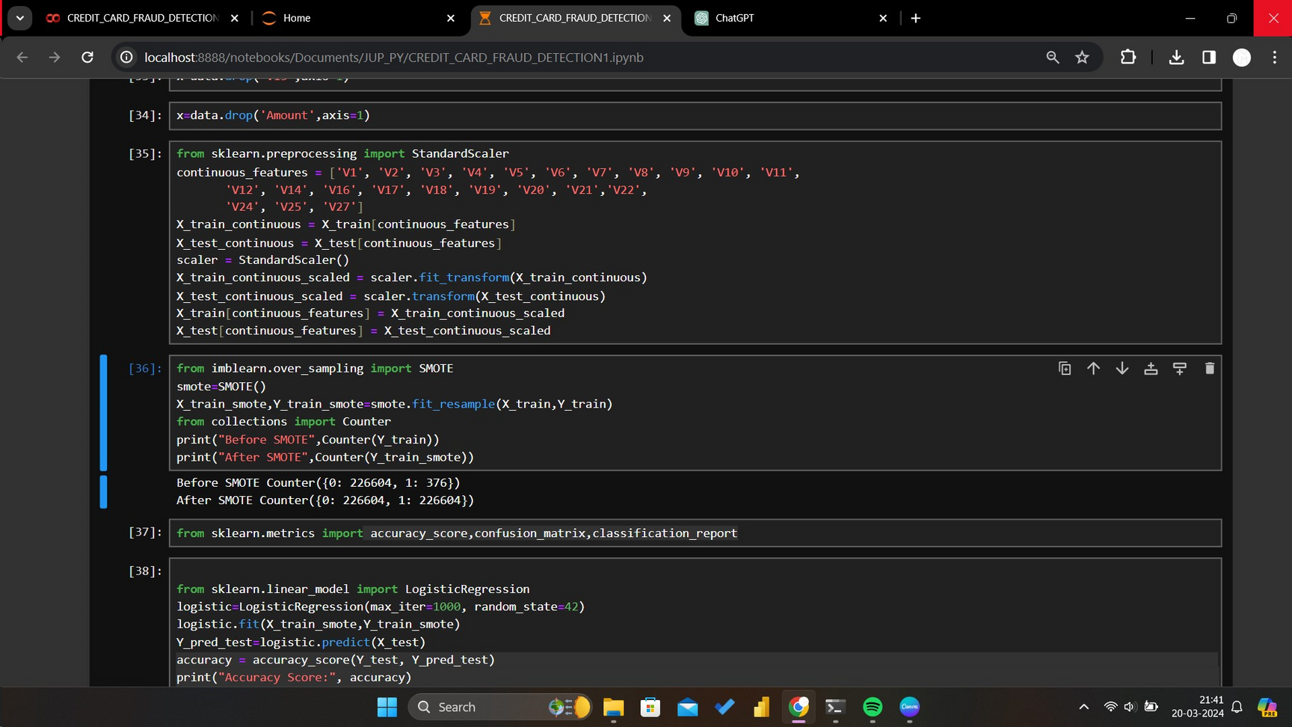
Highly imbalanced data
SMOTE performed

Slide 13

FEATURE SELECTION
Feature selection is a process in data science where the most relevant and informative features (or variables) are chosen from the original set of features in a dataset.
The goal is to improve model performance, reduce overfitting, and enhance interpretability by focusing on the most predictive and meaningful features

Slide 14


Avoid Overfitting
Reduce Dimensionality
Feature selection
Techniques
aim
Improve Model Performance
Enhance Interpretability

Slide 15
F-test (f_classif) for feature selection is performed to select the best features
f_classif is a function used for performing analysis of variance (ANOVA) F-test for feature selection in classification tasks. It computes the ANOVA F-value for each feature and its corresponding p-value. These values help determine the significance of each feature in discriminating between different classes in a classification problem

Slide 16
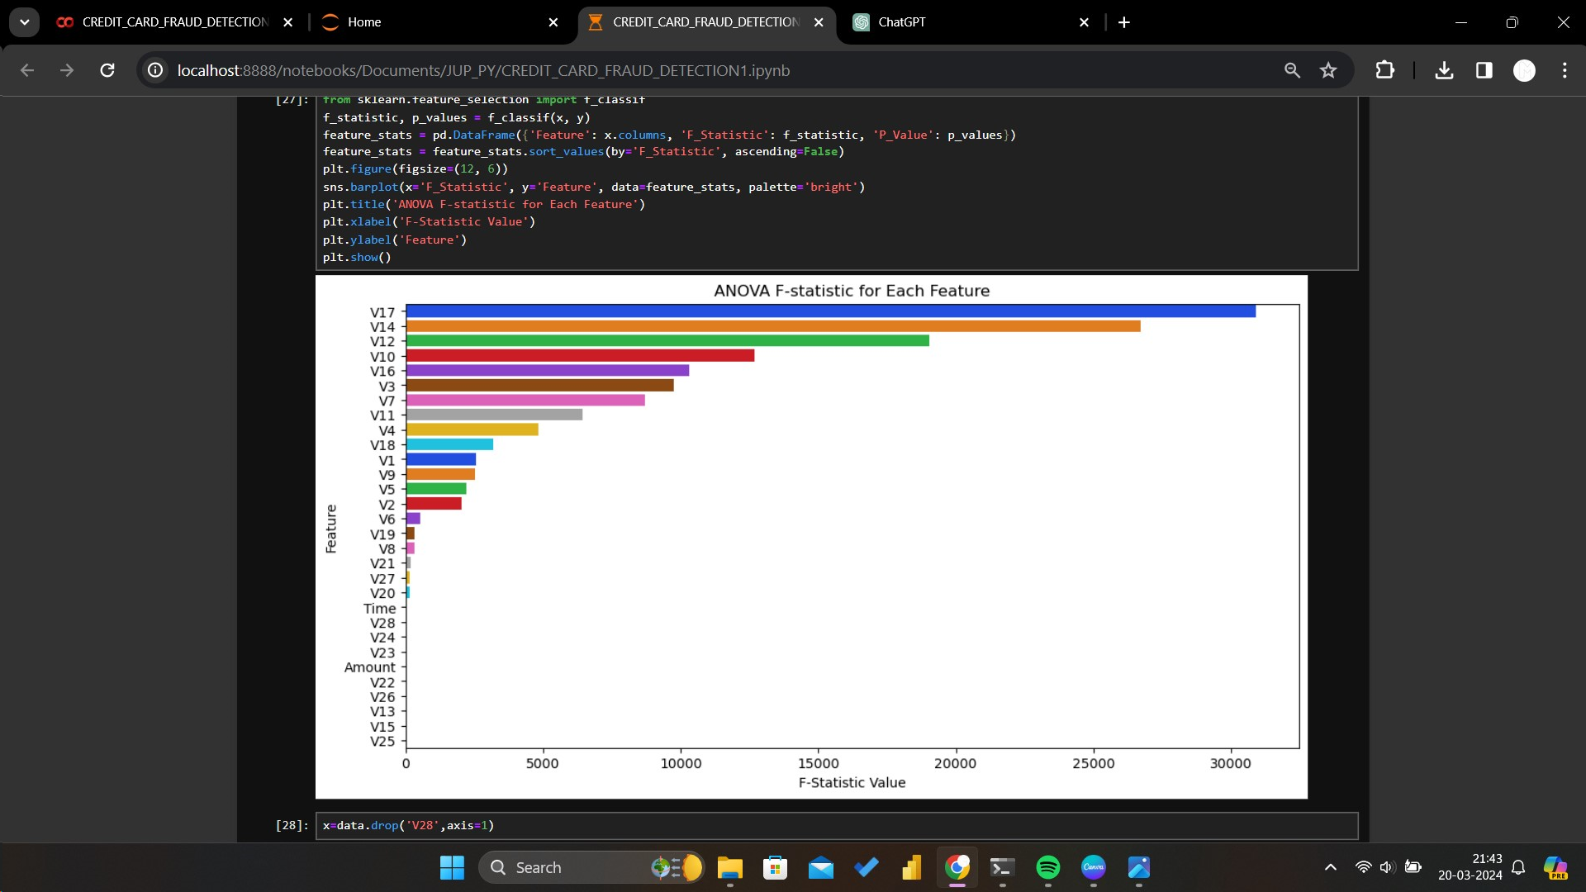
F-test (f_classif)

Slide 17
Remove unwanted features

Slide 18


MACHINE LEARNING MODELS
02
01
Decision Tree Classifier
Logistic Regression
03
04
Random Forest Classifier
Neural Network
03

Slide 19
EVALUATION METRICS
Accuracy: Accuracy measures the overall correctness of the model's predictions and is calculated as the ratio of correctly predicted instances to the total number of instances. However, accuracy alone may not be a reliable metric for imbalanced datasets where the number of fraudulent transactions is much smaller than legitimate ones.
Precision: Precision measures the proportion of true positives (correctly identified fraudulent transactions) among all transactions predicted as fraudulent. It is calculated as the ratio of true positives to the sum of true positives and false positives (legitimate transactions incorrectly classified as fraudulent). High precision indicates a low false positive rate, which is desirable in fraud detection to minimize the number of false alarms.Precision = True Positives / (True Positives + False Positives)
Recall (Sensitivity): Recall measures the proportion of true positives among all actual fraudulent transactions. It is calculated as the ratio of true positives to the sum of true positives and false negatives (fraudulent transactions incorrectly classified as legitimate). High recall indicates a low false negative rate, ensuring that most fraudulent transactions are detected.
Recall = True Positives / (True Positives + False Negatives)
01
03
Logistic Regression
Decision Tree Classifier
Random Forest Classifier
04
GaussianNB
05
04
06
Neural Network
KNeighbors
Classifier
SVC
03

Slide 20
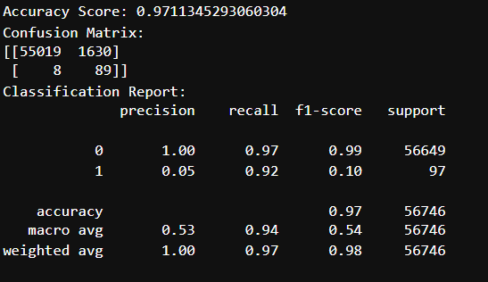
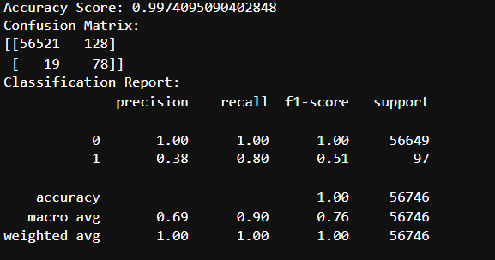
Logistic Regression
Decision Tree Classifier

Slide 21
Recall could be more important in detecting potentially harmful security threats
Finally observed that Decision tree is best model

Slide 22
Conclusion
In this project, I devised a novel approach for fraud detection. Utilizing the Synthetic Minority Over-sampling Technique (SMOTE), I balanced the dataset, leading to notable improvements in classifier performance. Moreover, I conducted feature selection to eliminate irrelevant features. Employing a techniques including Machine Learning,, I observed that Decision Tree is the best model.

Slide 23



THANK YOU VERY MUCH!

